Slide 1
Separated data in the RIPE Database
Denis Walker
Business Analyst, RIPE NCC

Slide 2
Problem statement
Maintaining a strong registry is important for the RIPE NCC
Users of this data need to have trust in its accuracy
The RIPE NCC has no direct control over resource Holders data entered into the RIPE Database
Users cannot easily distinguish between Maintainers of the data
Any inaccuracies found reflect on the whole data set.

Slide 3
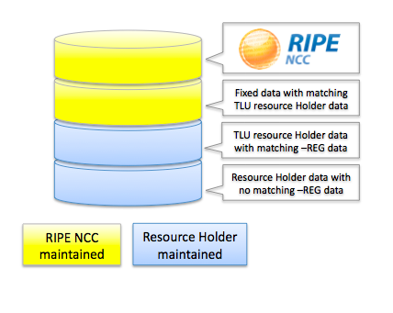
Goals and methodology
GOAL
Make it easy to identify who maintains each piece of data.
METHODOLOGY
Two physical layers reflecting split responsibility between RIPE NCC and resource Holder.

Slide 4
Separated data layers
Fixed registration data
Data supplied by the resource Holder
Maintained in the RIPE Database by the RIPE NCC
Resource Holder data
Data that can be changed by the resource Holder at any time.
Notes:
I think we should stress the point that fixed reg data is public presentation of the Registry

Slide 5
Benefits of the new service
Enhanced reliability
Easy to identify fixed data that has a high level of accuracy.
Easier reporting
Easier to identify the Maintainer of outdated or incorrect information.
Easier maintenance
Resource Holders can update data using any standard interface.

Slide 6
Overview of separated data
Four new object types
INET-REG
INET6-REG
AS-REG
ORG-REG
One deprecated object type
AS-BLOCK

Slide 7
Overview of separated data
Three new attributes
org-ref:
Created:
last-changed:
“–REG” objects are fixed
Resource Holders changeable data remains in standard objects
Data with shared Maintainer responsibilities split between a “–REG” and a standard object

Slide 8
Impact
No impact on resource Holder maintained more specific data and other object types
Some changes to users internal processes and software may be needed
Users may need to change any scripts used to parse query results where separated data is returned
Tighter implementation of address policy rules

Slide 9
Where is it?
http://labs.ripe.net/Members/Paul_P_/a-new-ripe-database-prototype
whois -h whois-four.db.ripe.net <query>

Slide 10
Questions?

