Slide 1

Application Layer Traffic Optimization (ALTO)
Network Positioning System
Stefano Previdi - sprevidi@cisco.com
Distinguished Engineer
Cisco Systems
RIPE61
Rome, November 2010

Slide 2
Cisco NPS Introduction
NPS Introduction/Overview
Service Applicability
Implementation
Groups and Policies
Next Steps
Summary

Slide 3
NPS
Introduction & Overview

Slide 4
ALTO/NPS Introduction
What:
  Application Layer Traffic Optimization (IETF ALTO): defines an API through which topology and infrastructure hint is requested by the application layer and delivered by the network layer/infra
  Network Positioning System: an ALTO implementation that computes the
  location of and distance between endpoints.
Why:
  Caching and replication are vital to optimization of network traffic.
  Distribution paradigms efficiency is augmented by dynamic mechanisms that locate (and determine distance to) services and data in order to optimize infrastructure resources utilization.
  Example: need to locate the nearest copy of a movie or the closest instance of a
  service among several available resources
How:
  ALTO: it is NOT in the scope of ALTO standardization effort to defines mechanisms used for deriving topology/infra information
  NPS: implementation of specific mechanisms and algorithms leveraging routing and infra layer databases leverages infra/routing layer and Policy information.
  Extensible to other information sources such as: state & performance and Geo-location

Slide 5

Cisco Network Positioning System
Architecture – Layer Separation
Application Layer
P2P
Swarms
OTT
Overlay
. . .
CDN
Cloud / *aaS
Request / Reply
Model
IETF API
NPS
NPS Server:
Information Collector
Algorithms
Databases
Geo-location
information
State and
performance
information
Policy
Database
Routing Protocols Databases:
ISIS, OSPF and BGP
Network Layer

Slide 6
ALTO / NPS
Application (e.g.: CDN) layer, has little visibility of the underlying infrastructure
Current application mechanisms: delay measurements, DNS, anycast, …
  As a consequence, current application overlays do not take into account infrastructure resources during their selection processes

Slide 7
Goals
  Service Provider goal: optimize his resources utilization while improving service delivered to CDNs, applications and OTT overlays
  CDN/Apps goals: improve user experience
  In general, a network-based NPS service has the advantage of better access to network topology, resources and policy information
  Best for the job:
    A server sitting in between network and application layer and delivering topology based hints to applications
    Access to topology and policy databases
    Delivers address ranking/preferences allowing definition of policies matching application (CDN) and network criteria

Slide 8
ALTO/NPS: Use Cases
Current implementation addresses following use cases:
  CDN
  Cloud Centric Networking
  Peer-to-Peer Networking
Foundation for the Service Routing Layer concept

Slide 9
NPS Service Applicability

Slide 10

Service Delivery
“Keep It Simple” approach:
  When CDN has to select content location for user, it asks NPS first
  Then, CDN includes NPS hint in selection process
Request Reply Model: Address Ranking
  Which targets in a given list of IP addresses are the closest to a particular
  query source (e.g.: user IP address) ?
  Simple location & distance request by application to network
  Extensible to other ranking criteria
REQUEST
User IP Add: 10.1.1.1
Target-1: 10.20.1.1
Target-2: 10.30.1.1
Target-3: 10.40.1.1
NPS Server:
Information Collector
Algorithms
Databases
CDN
?
REPLY
User IP Add: 10.1.1.1
Target-2: 10.30.1.1 10
Target-3: 10.40.1.1 20
Target-1: 10.20.1.1 30

Slide 11
Service Delivery
ALTO Client embedded in Application Server (CDN case)
App
Client
Content/Service Request
Network Topology Information Sources
Content Location-1
App
Server
ALTO
Client
Content Location-2
REPLY
User IP Add: 10.1.1.1
Target-2: 10.30.1.1 10
Target-3: 10.40.1.1 20
Target-1: 10.20.1.1 30
Routing Databases, Policy DB, NMS DB, GeoLoc, …
Content Location-3
ALTO/NPS
Engine
REQUEST
User IP Add: 10.1.1.1
Target-1: 10.20.1.1
Target-2: 10.30.1.1
Target-3: 10.40.1.1
NPS
Algorithms
NPS
DB

Slide 12
Service Delivery
ALTO/NPS Client embedded in Application Client (e.g.: peer-to-peer)
Network Topology Information Sources
Content Location-1
App
Client
ALTO
Client
Content Location-2
REPLY
User IP Add: 10.1.1.1
Target-2: 10.30.1.1 10
Target-3: 10.40.1.1 20
Target-1: 10.20.1.1 30
Routing Databases, Policy DB, NMS DB, GeoLoc, …
Content Location-3
REQUEST
User IP Add: 10.1.1.1
Target-1: 10.20.1.1
Target-2: 10.30.1.1
Target-3: 10.40.1.1
ALTO/NPS
Engine
NPS
Algorithms
NPS
DB

Slide 13
Use Case: Content Delivery Network
IP10
IP20
IP1
Content is located in
streamers IP10 and IP20.
SR sends request to NPS:
User: IP1
Targets: IP10, IP20
SR with NPS
Cient
HTTP Request from end-user to CDN
5
Redirect user to closest SE taking into account NPS and load
HTTP Request:
Get content from
closest SE
4
1
2
NPS/ALTOAPI
Layer Separation
3
NPS Reply with ranked
list of addresses:
User: IP1
Targets: IP20, IP10
NPS
Server
IP Layer
Policy DB
Routing Topology

Slide 14
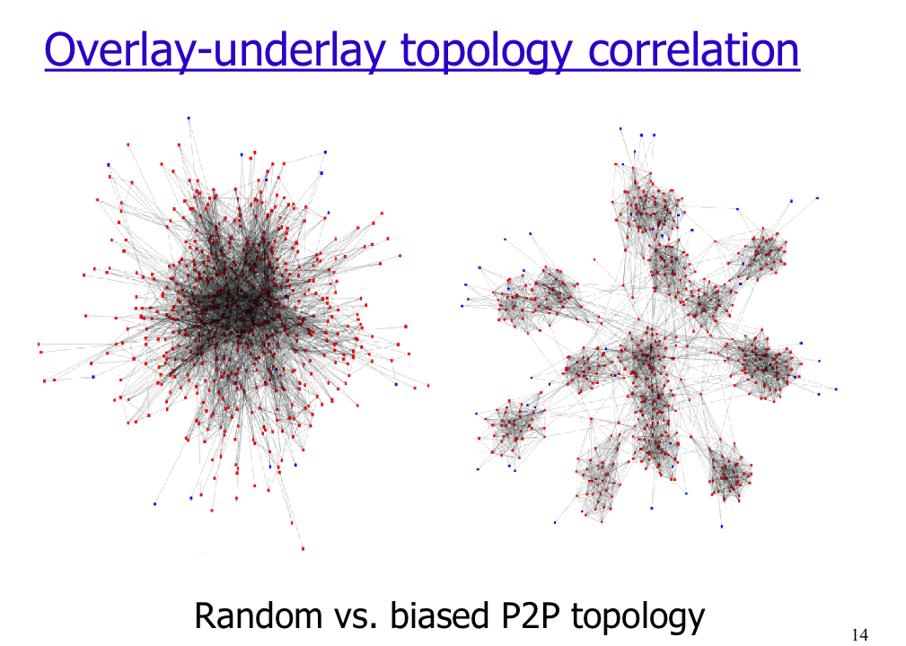
Use Case: Peer-to-peer overlays
NPS Engine receives request and rank IP addresses based on location
NPS Engine replies ranked list
of IP addresses
NPS Engine collects routing databases
(ISIS/OSPF/BGP/Policy)
3
4
P2p client sends NPS
Request with list of
addresses to rank
0
2
Routing/Infra DB
NPS
Engine
NPS/ALTO API
Policy DB
P2P client finds content and list of peers (IP addr)
1
peer-to-peer
network
Source:
  Vinay Aggarwal, Anja Feldmann, Christian Scheideler.
  Can ISPs and P2P systems co-operate for improved
  performance? ACM SIGCOMM Computer
  Communications Review, Volume 37, Number 3,
  July 2007.

Slide 15





Service Provider perspective
Example: transit links
Preserve high cost bandwidth: transit links
Apply policies to topology visibility delivered to upper layers
C
Transit
Provider
B
Where is the closest
location for this
NPS
$$$
Transit Links
A

Slide 16



Cloud Centric Networking Use Case
1
4
1
Additional Capacity Needs – Request Cloud Resources
Workload increase
Workload Deployed
Cloud
Data Center
Request resources
Internal
Data Center
2
Check Availability, Performance, Determine Optimal Location
2
Cloud VPN
3
Self-provision Network Tenant, Virtual Compute, Storage, VPN
3
Core
Cloud
Data Center
4
vDC Active
Cloud
Data Center
Notes:
Here’s another example
Say, a big company does payroll processing at the end of the month.
In these cases, there’s going to be a temporary need for more compute capacity.
Normally, this kind of provisioning requires manual intervention.
However, using business rules, a cloud-aware CRS-3 can automatically request additional capacity from the data centers. . .
The NPS identifies the datacenter with available capacity
And the Cloud VPN capability automatically provisions VPNs, identify SLAs and manages security as the additional data center is brought on board.

Slide 17
NPS Implementation

Slide 18
Network Positioning System (NPS)
An ALTO implementation
How to determine location and distance ?
  Topology: Routing Databases (IGP/BGP)
  Additional information sources: NMS, Geolocation, BGP LG, …
  Policy: Prefix Groups / BGP Communities
  Cost/weight between group of prefixes (communities)
How to best rank addresses ?
  Aggregate/combine results from multiple algorithms (routing, policy, groups)
How to ensure security/confidentiality
between application and network layers?
  No information is leaked in either way
  Clear layer isolation
P2P
Swarms
CDNs
Cloud / *aaS
Layer Separation – No topology information leaking
NPS Server:
Information Collector
Algorithms
Databases
Policy
DB
Routing Protocols Databases:
ISIS, OSPF and BGP

Slide 19
Network Positioning System (NPS)
An ALTO implementation
How to reconstruct network topology ?
  IGP Boundaries, BGP location dependent visibility
  Collect IGP (Link-State) and BGP databases
  Take into account area/level and AS boundaries
Network visibility is related to location
  Area vs. backbone, intra-AS Vs. inter-AS
  A NPS server sitting in AS-x will not have topology info about AS-y
Inter-AS NPS, two strategies:
  Share information between Autonomous Systems
  Re-direct requests to best NPS server

Slide 20

Network Positioning System (NPS)
An ALTO implementation
IGP based NPS Proximity algorithm leverages IGP link-state information and determines optimal choice for least impact on backbone infrastructure
  IGP choice: prefer target with closest exit point
Extensions to routing algorithms as used in the routing layer
  NPS extensions for NPS purpose: traffic direction, selection process
NPS

Slide 21
Network Positioning System (NPS)
An ALTO implementation
BGP based NPS Proximity algorithm leverages IGP and BGP information and determines optimal choice based on both backbone infrastructure and inter-AS policies
BGP Policy mechanisms used by NPS to determine best location
NPS
NPS
NPS

Slide 22
Network Positioning System (NPS)
An ALTO implementation
Correlation between information sources: IGP/BGP/Policy
Re-build the full picture of the network topology for the purpose of the application
NPS
NPS

Slide 23
ALTO / Network Positioning System
Inter-NPS Communications
NPS acquires routing information from within the AS
Requests received within the AS are locally server
Requests received for addresses outside the AS will be re-directed to NPS server located in addresses’ AS
NPS servers exchange info
NPS Server
Inter-NPS Ring
NPS Server
NPS Server
IGP/BGP Adj
IGP/BGP Adj
IGP/BGP Adj
AS 3
AS 1
AS 2

Slide 24
ALTO / Network Positioning System - Redirection
Strategy: redirect user request to NPS server having better network visibility
Algorithm leverages BGP and NPS databases
When configured, NPS server establish a private overlay
  NPS addresses and AS# are known in the NPS ring
  NPS redirects SR to NPS in user’s AS
NPS-1
NPS-2
NPS-1
Inter-NPS Ring
NPS-2
IP20
3. Redirect:
NPS-2
2. Request-1:
User: IP2
Targets: IP10, IP20
4. Request-2:
PSA: IP2
PTL: IP10, IP20
5. Reply:
PSA: IP2
PTL: IP20, IP10
7. Content Download
IP10
IP2
CDNs
1. Content Request
6. HTTP Redirect

Slide 25
NPS Grouping and
Policy Methods

Slide 26
NPS/ALTO: Groups and Maps
Location definition may override routing visibility
  Not everything can be grouped through prefix aggregation
Need for a policy mechanism allowing to group prefixes
  Good news: it’s available and called BGP Communities
Example: Users in POP1 should first prefer streamers in POP3, then POP2
Requires:
  Ability to group prefixes other than through routing paradigm: BGP Community Tagging
  Ability to define distance/cost/preferences between groups: Policy definition in NPS server
POP 1
POP 3
POP 2
Preference 1
Preference 2

Slide 27
NPS/ALTO: Groups and Maps
From topology to groups
Abstract level of topology
Addresses application requirements in terms of NPS services
Gives powerful policy control on NPS algorithms
Dynamic and static mechanisms
Grp-1
Grp-2
Routing DBs
and
NPS Algorithms
Grp-3
Cost Matrix
Grp-6
Grp-4
Grp-5

Slide 28
NPS: Grouping and Policies
Current implementation:
  NPS co-locates endpoints having prefixes with same BGP Community value
  NPS allow to define arbitrary weight between communities
  Example:
  source-community 111:789 target-community 111:789 weight 5
  source-community 111:789 target-community 111:123 weight 3
  source-community 111:789 target-community 111:456 weight 1
BGP routes with community: 111:123
11.4.1.1
11.4.2.1
NPS
BGP routes with community: 111:456
RR
BGP routes with community: 111:789
11.2.1.1
11.3.1.1
11.2.2.1
AS 111
11.3.2.1

Slide 29
NPS: Grouping and Policies
Goals:
  Deliver a tool for SPs to implement and deploy NPS policies
  reflecting existing network layer policies and applied to applications
Topology visibility at network layer makes little sense for application
  No need to know topology atomic details
  Need to preserve confidentiality between layers
Scale NPS services in different application contexts
  Deliver NPS services based on different “views” of the network according to different applications
Two components:
  Grouping method
  Cost Matrix/Map

Slide 30
NPS: Grouping and Policies
Components
Grouping method:
  How to efficiently group prefixes/addresses
  SP need to define groups not corresponding to pure IP grouping methods (prefix/summary/AS)
  Groups should be able to reflect any policy criteria:
  Location, connectivity type, service, …
  Grouping method should be capable of leveraging existing grouping methods deployed in SP infrastructure
  BGP Community is used by most SPs as a grouping method
Cost Matrix
  Policy and cost definition between groups

Slide 31
NPS: Aggregated Topology Algorithms
Current deployments allow to leverage BGP Communities
  BGP Communities represent location: PoP/City/Region/…
  Additional numbering schemes can be deployed to represent new groups
  NPS Server handle the change: NO IMPACT ON NETWORK
NPS algorithms leverage community attributes in order to derive the aggregate topology map
Current implementation use Community matching criteria
  strict-match
  weighted match
  exclusion
Example:
  source-community 123:1234 target-community 123:4567 weight 5

Slide 32
NPS: Grouping and Policies
View-1
Grp-1
Grp-2
Grp-3
Cost Matrix
Grp-6
Grp-4
Grp-5
View-2
Grp-1
Grp-3
Cost Matrix
Grp-6
Grp-5
View-3
Grp-2
Cost Matrix
Grp-4
Grp-5
From Topology and Policies to Maps

Slide 33
NPS Next Steps

Slide 34
NPS/ALTO Implementation Enhancements
Add NPS information sources
  Resources Utilization
  Performance
  Geo-location
  Layer-2 Topology Information
  Service Awareness (Service Routing)
Support of different Address-Families
  V4/V6, VPN-V4/VPN-V6
Integration with Routing SW

Slide 35
Summary

Slide 36
ALTO / Network Positioning System (NPS)
Summary
NPS is a service delivered by the SP network to application layer
  CDN, VoIP, P2P, Clouds, …
NPS Service consists of delivering:
  Cost rating preferences of IP addresses/subnets
  Reflecting topology, state, performance and policies implemented in the network
Available shipped Implementations

Slide 37
ALTO / Network Positioning System (NPS)
Summary
Different mechanisms are available in order to leverage topology information
  Dynamic: routing protocols databases
  Policy-based: through Maps configuration
NPS will integrate multiple network information sources in order to deliver accurate and efficient ranking services to applications

Slide 38
ALTO / Network Positioning System (NPS)
Summary
NPS Client
  Embedded into application client or
  Embedded in application server/portal
  Selection is improved by ranked list delivered by NPS server
NPS Server
  Interfaces with network and infrastructure layer.
  Receives NPS Requests
  Returns requests with ranked lists

Slide 39
Thank You !
Notes:
39

